Slide 1
Introduction to Clinical Pharmacology Chapter 4 The Nursing Process Paula Reeves BSN, RN

Slide 2
Learning Objectives
List the five phases of the nursing process.
Discuss assessment, analysis, nursing diagnosis, planning, implementation, and evaluation as they apply to the administration of drugs.
Differentiate between objective and subjective data.
Identify common nursing diagnoses used in the administration of drugs and nursing interventions related to each diagnosis.

Slide 3

What Is the Nursing Process?
A framework for how nurses problem-solve and take action to provide effective client care.
A specific and orderly plan to gather data, identify client problems, develop outcomes, implement a plan of action, and evaluate the results.

Slide 4
The Five Phases of the Nursing Process
Assessment
Nursing diagnosis
Planning
Implementation
Evaluation

Slide 5

Phase #1 of the Nursing Process: Assessment
Assessment: collecting objective and subjective data
Objective data
Facts obtained by means of a physical assessment, physical examination
Subjective data
Facts supplied by client or client’s family

Slide 6
Types of Assessments
Initial (baseline)
Conducted when a client is first seen for care
More thorough
Provides a baseline of data for comparison at a later time
Ongoing
Conducted at each client encounter
Allows for comparison with baseline data

Slide 7
Important Objective and Subjective Assessment Data When Administering Drugs
Drugs can have many effects on the body.
The nurse must gather objective and subjective data at baseline and on an ongoing basis to understand if drugs have their desired effect or if a client is experiencing side effects or adverse reactions.
Objective Assessment Data for Drug Administration
Blood pressure, pulse, respiratory rate, temperature, weight, appearance, and auscultation of lung sounds
Subjective Assessment Data for Drug Administration
Statements from the client about relief or nonrelief of pain or other symptoms before and after the administration of the drug

Slide 8

Pharmacology in Practice Exercise #1
A nurse is caring for a client who is of childbearing age. Which of the following is the most relevant assessment that the nurse should perform before administering a drug to this client?
Family history
Relationship with spouse
Pregnancy status
Menstruation status

Slide 9
Phase #2 of the Nursing Process: Nursing Diagnosis
Nursing diagnosis
A method using clinical judgment to identity problems that can be solved or prevented by independent nursing actions
Based on the nurse's assessment and analysis of client’s problems and their probable or actual related causes based on subjective, objective data
North American Nursing Diagnosis Association (NANDA-1): formed to standardize the terminology used for nursing diagnoses
Provides a framework for selection of nursing interventions to achieve expected outcomes

Slide 10
Common Nursing Diagnoses Used During Drug Administration
Dehydration
Health Seeking Behavior
Altered Health Management
Deficient Knowledge
Anxiety
Readiness for enhanced health management
Ineffective health management
Noncompliance

Slide 11
Phase #3 of the Nursing Process: Planning #1
The nurse develops expected outcomes after nursing diagnoses are formulated
Goal statement: a broad expectation that will indicate a client problem is solved
Expected outcome: a direct statement of how client goals are to be achieved and is attainable by the client
Expected outcomes should be specific, measurable, achievable, relevant, and time-bound
Example goal:
The client will effectively manage the drug regimen.
Example expected outcome:
The client will take the medication(s) as prescribed by the provider after the client leaves the health care facility.

Slide 12

Phase #3 of the Nursing Process: Planning #2
During the planning phase, the nurse also selects appropriate interventions on basis of expected outcomes to develop plan of action or client care plan
Planning phase: describes the steps for carrying out nursing activities or interventions that are specific and that will meet the expected outcomes
Expected outcomes serve as basis for evaluating the effectiveness of nursing interventions

Slide 13

Phase #4 of the Nursing Process: Implementation #1
Implementation:
Carrying out of a plan of action
In relation to drug administration, implementation refers to the preparation and administration of one or more drugs to a specific client

Slide 14
Phase #4 of the Nursing Process: Implementation #2
Before administering a drug, the nurse should review subjective and objective data obtained during assessment
The decision of whether to administer the drug is based on the analysis of all the assessment data
Example, if a client had a baseline blood pressure 188/110 and the pre-administration (ongoing) blood pressure was 182/110, the nurse would still administer the medication prescribed to manage hypertension
Example, if a client had a baseline blood pressure of 188/110 and the pre-administration (ongoing) blood pressure suddenly dropped to 98/70, the nurse could decide to withhold the drug and notify the health care provider

Slide 15

Phase #4 of the Nursing Process: Implementation #3
Nursing Actions Based upon Nursing Diagnosis Related to Drug Administration
Health Seeking Behavior
Client is seeking and willing to promote well-being
Willing to participate and integrate daily living treatment of an illness through the self-administration of medication
The nursing actions would be to:
Provide information about the drug
Provide instruction on how to administer the drug
Teach the client about what reactions to expect
Teach the client about what to report to the health care provider

Slide 16

Phase #4 of the Nursing Process: Implementation #4
Nursing Actions Based Upon Nursing Diagnosis Related to Drug Administration
Altered Health Management
Inability of client to integrate into daily living a program for treatment of illness and the effects of the illness
The client may not be taking the medication correctly because of something that hampers their ability due to a barrier to learning or understanding.
The nursing actions would be to:
Further assess the client's level of health literacy
Observe the client as they self-administer the drug before discharge from the health care facility
Instruct the client on anticipated positive and negative effects of the drug
Determine if adequate funds are available to obtain the drug and any necessary supplies

Slide 17
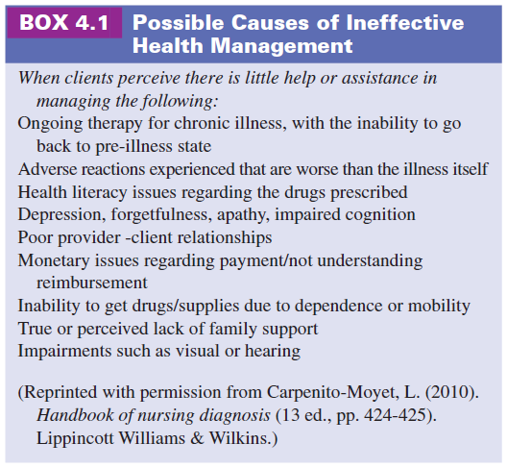
Phase #4 of the Nursing Process: Implementation #5
Altered Health Management

Slide 18

Phase #4 of the Nursing Process: Implementation #6
Nursing Actions Based Upon Nursing Diagnosis Related to Drug Administration
Deficient Knowledge
The absence or deficiency of cognitive information on a specific subject.
The client lacks specific knowledge to administer the drug regimen correctly.
The nursing actions would be to:
Assess what information the client is lacking
Plan a teaching session that directly pertains to the specific area of need
Consider teaching one or more caregivers to administer the proper treatment regimen

Slide 19

Phase #4 of the Nursing Process: Implementation #7
Nursing Actions Based Upon Nursing Diagnosis Related to Drug Administration
Anxiety
Vague uneasiness or apprehension that manifests itself in varying degrees from expressions of concern to total lack of adherence to the drug routine.
Clients or caregivers can experience anxiety during medication administration or during client/caregiver teaching.
The nursing actions would be to:
Identify and address the specific fear
Reassure the client that the drug will alleviate the symptoms, or if possible, cure the disorder
Thoroughly explain any procedure
Actively listen and encourage the client or caregiver when they express fears and concerns
Reassure the client or caregiver

Slide 20

Pharmacology in Practice Exercise #2
A nurse is caring for a client who has to continue with the drug regimen on an outpatient basis. Ongoing assessments of the client reveal that the client is not adhering to the medication regimen. What is the first task the nurse should perform to support client adherence?
Prepare a fixed schedule for the client to take the drug
Find out the reason for nonadherence if possible
Teach the client the importance of following a drug regimen
Frequently monitor the client's condition to identify a relapse

Slide 21
Phase #5 of the Nursing Process: Evaluation
Decision-making process that involves determining effectiveness of nursing interventions in meeting expected outcomes
Used to determine if the client or family member understands the drug regimen
Used to evaluate the client’s response to therapy (examples):
check client’s blood pressure every hour,
inquire whether pain has been relieved, or
monitor pulse every 15 minutes
Evaluation is complete if the expected outcomes are accomplished or if progress occurs
If outcomes are not accomplished the nursing process would begin again and new interventions might be needed

Slide 22
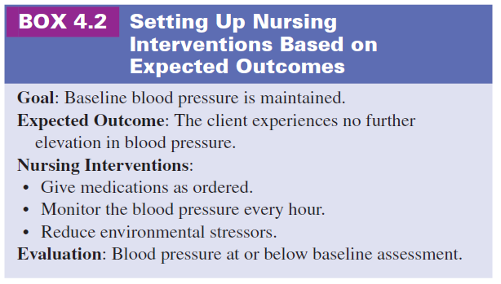
Setting Up Nursing Interventions Based on Expected Outcomes

Slide 23
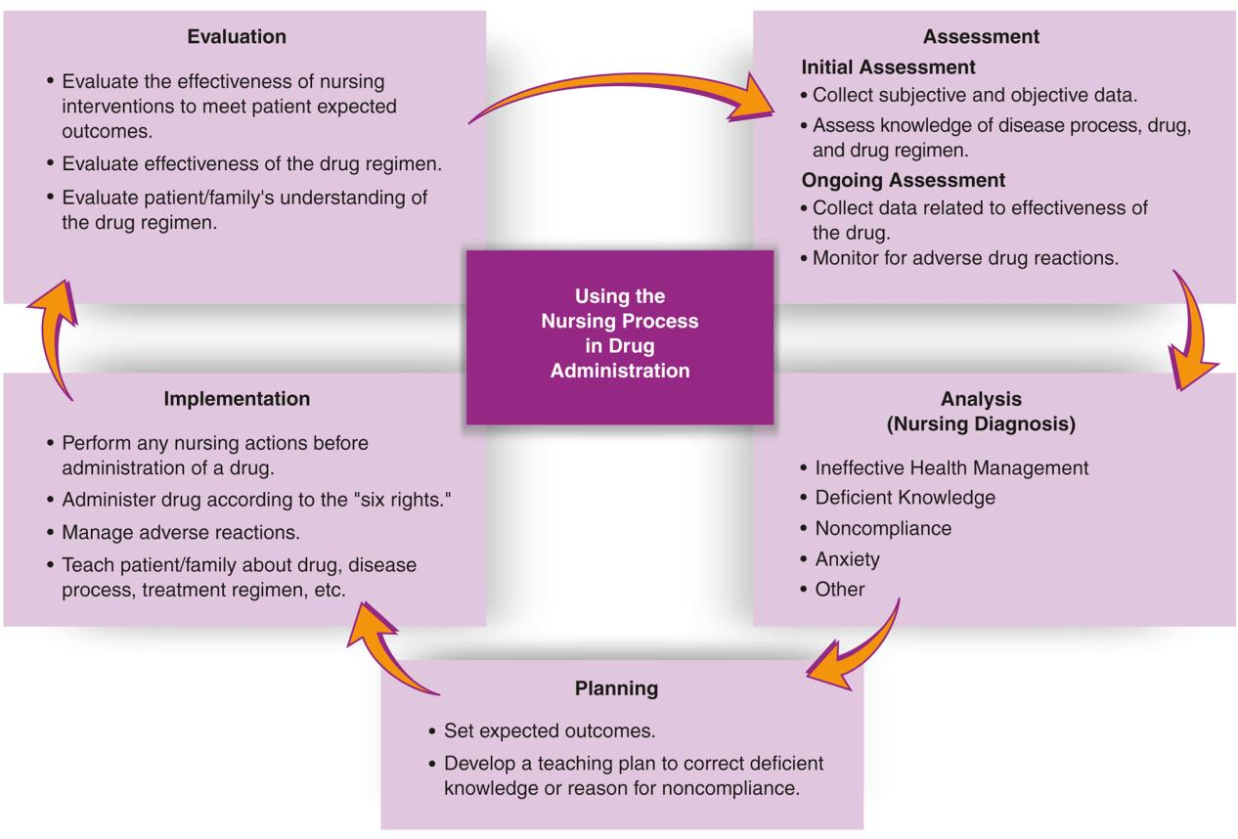
Seeing the Big Picture: How the Five Phases of the Nursing Process Work Together in Drug Administration

Slide 24
Turn and Talk—Case Study
Mary Rockwell is a 32-year-old woman, para 2, gravida 1. She has pregnancy-induced hypertension and gestational diabetes. She presents to the physician today for follow-up.
What information should the nurse gather from Ms. Rockwell during the initial assessment?
Ms. Rockwell’s physician has ordered her to do finger sticks four times a day. What can the nurse do to ensure that the client follows the therapeutic regimen?
Ms. Rockwell expresses anxiety about the newly diagnosed diseases and testing procedure. What can the nurse do to decrease her anxiety?

